Slide 1

Fnatic Web Portal
Svetoslav Lazarov
https://github.com/zazor

Slide 2

Fnatic – what is this?
Fnatic is a leading organisation in eSports, with professional teams in the most popular games such as: League of Legends, Dota 2, Battlefield 4, and more. Players attend more than 75 international events per year, representing the brand in every corner of the world.

Slide 3

Fnatic Web Portal – purpose.
Fnatic Web Portal is an internal portal which will be used by players and managers which are “working” for Fnatic organization. Users can add information such as nicknames, achievements etc. in their own profiles. This information is easily accessible among Users, based on what game they are playing/managing.

Slide 4

Main features
User registration
User dashboard
View user information
Edit user information
View other users information based on specific criteria

Slide 5
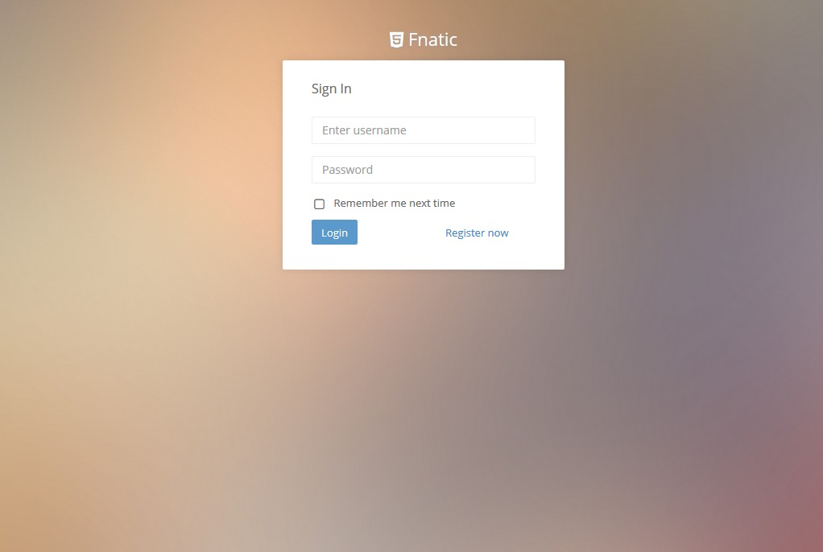
Action time!

Slide 6
Questions?

